Slide 1
Exercise 6
BIOENG-310: Neuroscience Foundations for Engineers
Yingtian Tiang
Alejandro Rodriguez Guajardo

Slide 2
Context of the Exercise
We will use a dataset from Freeman & Ziemba, 2013, a study on V1 and V2 responses to visual textures in macaque monkeys.
Objective: Learn how to create and manipulate Gabor filters and RDM
Gabor filtering: construct Gabor filters (lots of work)
Alignment between Gabor filtering and monkey V1 activity: using RDMs to compare Gabor features and V1 activities

Slide 3
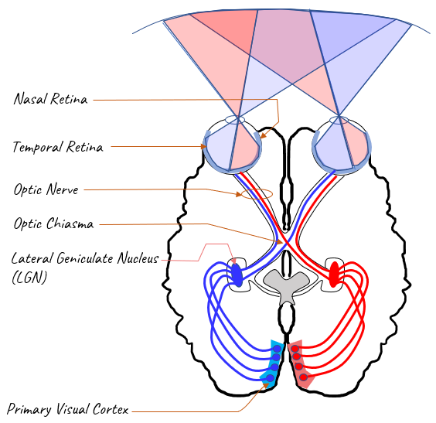
Overview of the visual system

Slide 4
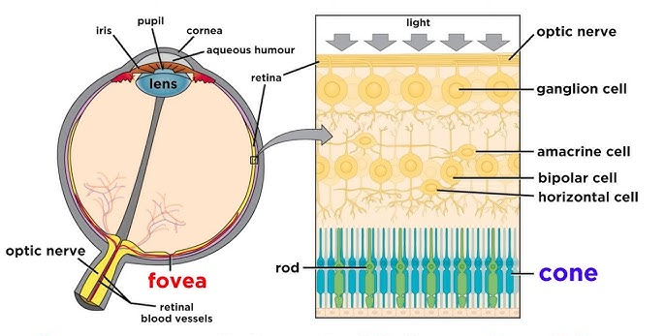

Slide 5
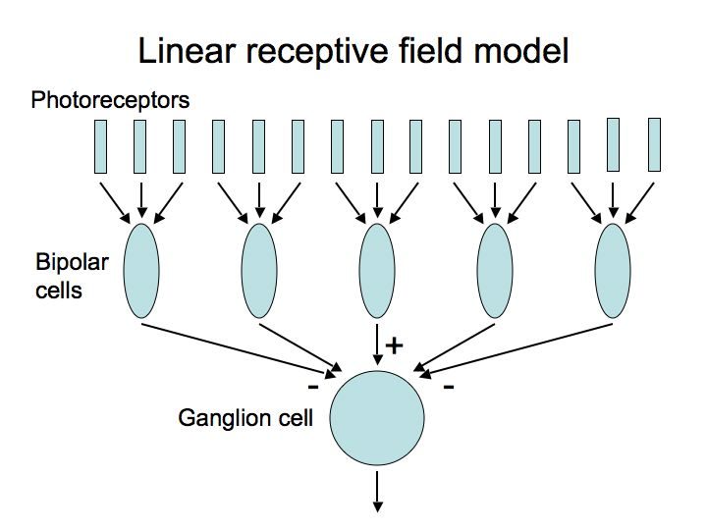
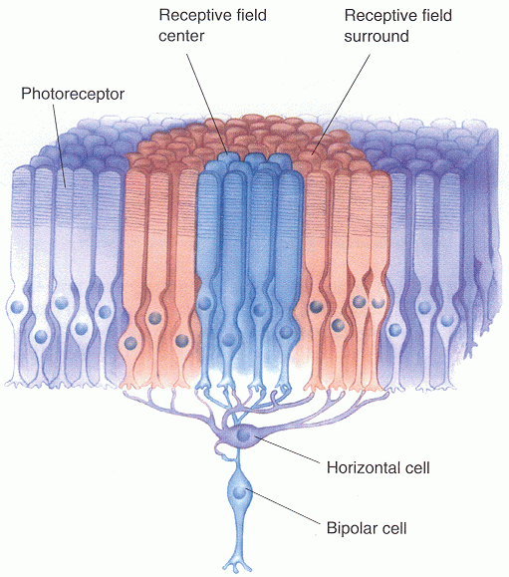
To optic nerve

Slide 6
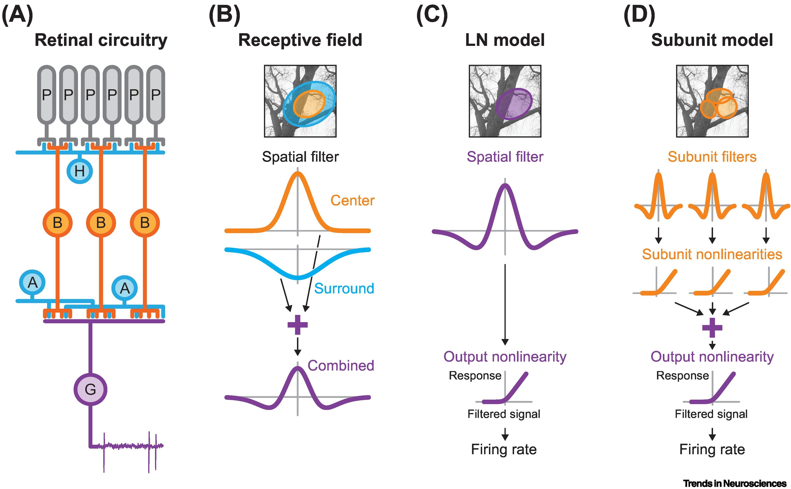
Notes:
(A) Schematic retinal circuitry, comprising photoreceptors (P), bipolar cells (B), two types of inhibitory interneurons [horizontal (H) and amacrine (A) cells], and a ganglion cell (G). Visual information propagates from top to bottom. The output is the spiking response of the ganglion cell, as indicated here by an extracellularly recorded voltage trace. (B) Ganglion cell center-surround receptive field, depicted here as a difference-of-Gaussians model. The spatial filter that comprises the receptive field contains a positive 2D Gaussian function for the center (orange, shown here as a 1D Gaussian cross-section) and a concentric, but broader negative Gaussian function for the surround (blue). The filter signals, obtained as weighted sums of pixel values, are added, yielding the combined receptive-field activation. Center and surround are attributed to excitatory bipolar cells and inhibitory interneurons, respectively, as indicated by the corresponding colors. Top: illustration of center and surround as 2D outlines overlaid on a visual stimulus. (C) Spatial linear–nonlinear (LN) model. First, a spatial filter, representing the receptive field of the ganglion cell, is applied to the visual stimulus, corresponding to a weighted summation of stimulus pixel values. The filtered signal is subsequently passed through a nonlinear transformation to produce the response of the ganglion cell, measured, for example, as the evoked firing rate. (D) Subunit model. Multiple subunits act as spatial filters with subsequent nonlinearities. Their responses are summed in a weighted manner and passed through a final nonlinearity to produce the response of the ganglion cell (e.g., firing rate).

Slide 7
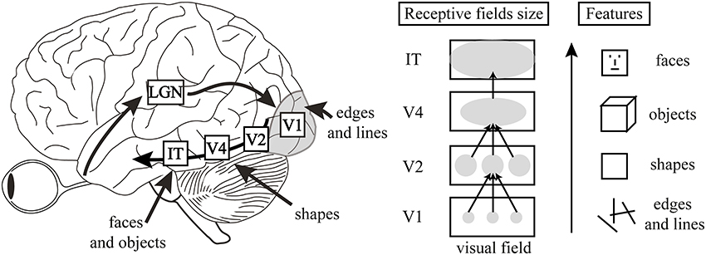

Slide 8
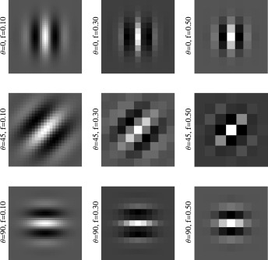
What are Gabor Filters?
Gabor filters are a class of linear filters used for texture and edge analysis in image processing.
They are based on the mathematical concept of a sinusoidal wave (sine or cosine) modulated by a Gaussian envelope.

Slide 9
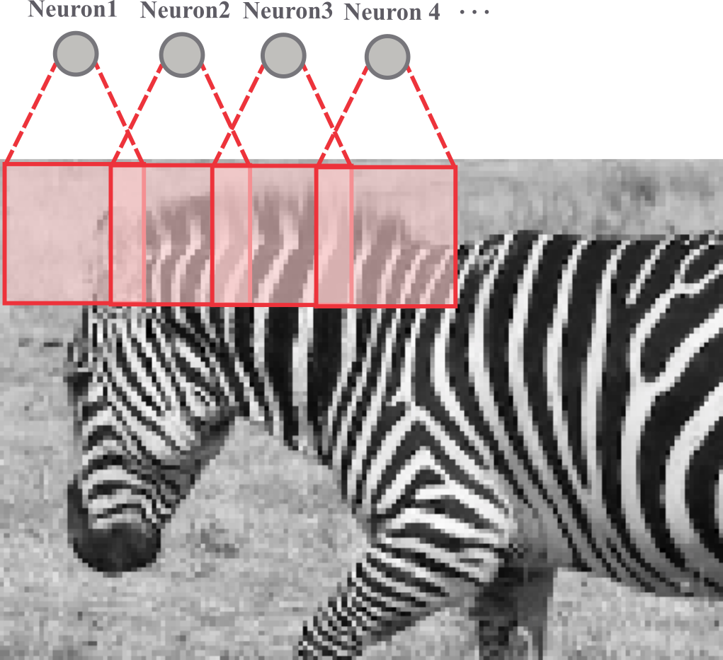

Slide 10
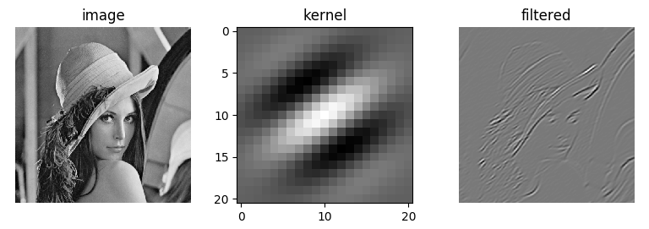

Slide 11
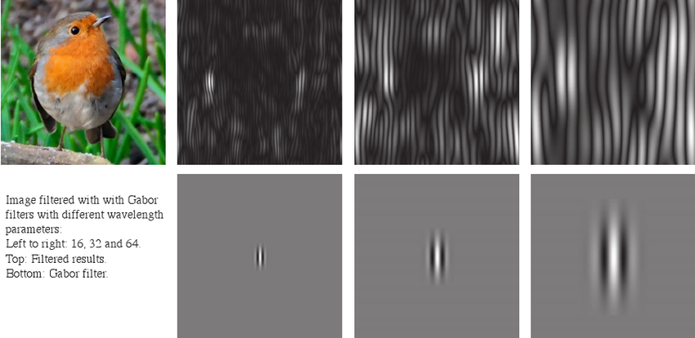

Slide 12
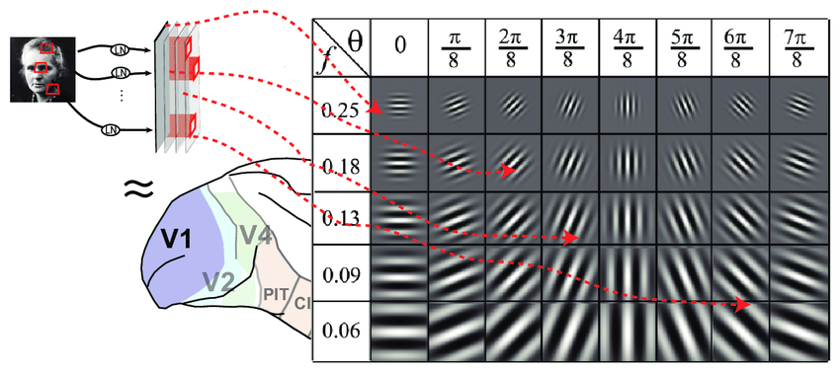
Role in Vision
Gabor filters are thought to model the way the human visual system processes spatial and frequency information.
They mimic the receptive fields of neurons in the visual cortex, particularly those involved in edge detection and spatial frequency analysis.

Slide 13
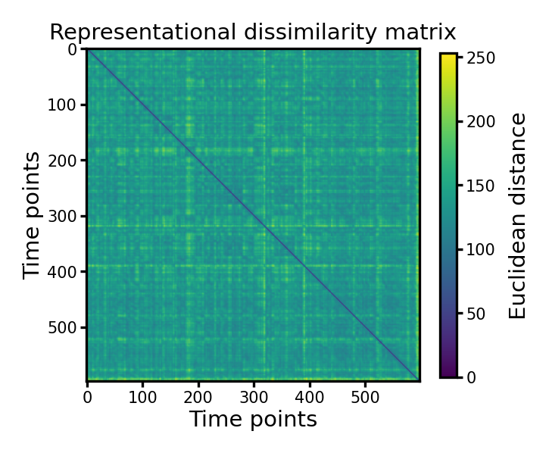
Representational Dissimilarity Matrices (RDMs)
Tools used to measure the dissimilarity between different representations of stimuli in a high-dimensional space.
They capture the pairwise dissimilarities between different stimuli based on how they are represented in a given system (e.g., neural representations or computational models).
RDMs are often used to compare the similarity between different brain regions or models when processing similar inputs.

Slide 14
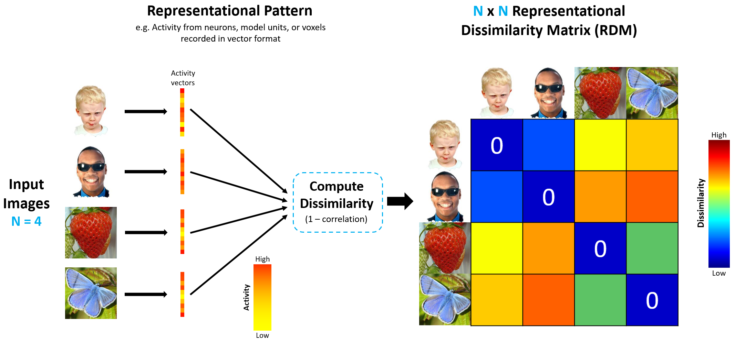

Slide 15
Questions?

